Slide 1


Slide 2

Java OOP and Data Structures with Introduction to Secure Coding Dr. Ziping Liu
Chapter 5 Inheritance and Polymorphism

Slide 3
https://he.kendallhunt.com/product/java-oop-and-data-structures-introduction-secure-coding
Chapter 5 Inheritance and Polymorphism

Slide 4

Chapter Outlines
Understanding the inheritance (“is a”) relationship
Defining the superclass
Defining subclasses
Leveraging polymorphism
Understanding subtyping relationships
Using the virtual method table
Differentiating between a variable’s static type and dynamic class
Understanding how polymorphism and dynamic dispatch interact

Slide 5
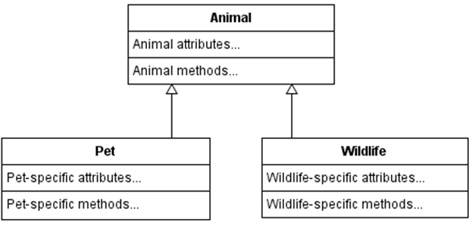
5.1 Inheritance (“Is a”) Relationship
the inheritance—or “is a”—relationship describes classes that do share some attributes and/or methods
any particular superclass can have many subclasses, but each subclass can inherit from one and only one superclass

Slide 6
5.1 Inheritance (“Is a”) Relationship
Core Concept: inheritance (“is a”) relationship
Superclass: the more generalized class; may have multiple subclasses Subclass: the more specialized class; can only have one superclass
We say that the subclass IS A type of the superclass. The subclass shares the attributes and methods of the superclass.

Slide 7
5.2 Defining the Superclass
The protected Keyword
By defining a variable or method as protected, we allow subclasses that inherit from the current class to directly access that variable or method. However, other classes that do not inherit from the current class cannot access protected fields.
Using protected visibility allows subclasses to share attributes and methods of the superclass. It gives us a way to fully operationalize the inheritance relationship by controlling which data members and methods we want subclasses to inherit and which belong strictly to the superclass. The protected keyword allows us to preserve encapsulation in OOP design when classes share common features.

Slide 8
5.2 Defining the Superclass
The protected Keyword
Core Concept: protected visibility
Suppose a variable or method in class A is defined as protected. And, suppose that class B inherits from A, but class C does not. Then, B can access the protected member in A, but C cannot.

Slide 9
5.2 Defining the Superclass
Core Concept: encapsulation
Do not let external users directly access instance variables. Keep these instance variables private.
Safely encapsulate an object’s state. Safe encapsulation: external users cannot DIRECTLY access instance variables.
Safe access of instance variables: Create public accessor methods… …but only for those instance variables that you want users to see. …and, for objects, return clones (deep copies), not aliases (or shallow copies)!
Safe changes to instance variables: Create public mutator methods… …that check for “bad” input values first… …but only for those instance variables that you want users to update.
In inheritance relationships: Make protected those fields and methods that you would like subclasses to inherit.

Slide 10
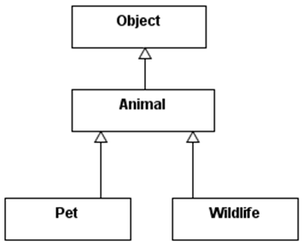
5.2 Defining the Superclass
The @Override Annotation
Object is the root of all inheritance trees

Slide 11
5.2 Defining the Superclass
The @Override Annotation
If we wanted an implementation specific to the subclass, we would need to override its superclass’s implementations
Mark a method with @Override above the method header to specify that a subclass should use the following implementation of that method instead of its inherited version from its superclass
To properly conduct the override operation, we need to make sure that the method header and return type exactly match the superclass’s method header and return type

Slide 12
5.3 Defining Subclasses
The extends Keyword
Syntax: defining a subclass
[public/private/protected] class SubclassName extends SuperclassName { Variables (class-specific) here... Methods (class-specific and/or overridden) here... }

Slide 13
5.3 Defining Subclasses
The super Keyword
refers to aspects of a class’s superclass
super(): invoke the constructor of the superclass
first set up the superclass variables through a call to super() before initializing the subclass-specific variables in the subclass’s constructor(s)

Slide 14
5.3 Defining Subclasses
Overriding Methods of the Superclass
@Override Annotation

Slide 15


Slide 16


Slide 17
5.4 Polymorphism
Java is a Strongly Typed Language
must specify the type for every variable. And, once a variable is declared to be of some type, it must always remain that type
Animal a = new Animal();
a = new Object(); // not allowed
a = new Pet(); // allowed
a = new Wildlife(); //allowed

Slide 18
5.4 Polymorphism
Inheritance Creates Subtyping Relationships
By definition, if class A inherits from class B, the inheritance relationship between them implies that A is a B. Specifically, this means that A is a subtype of B. All subclasses of B are subtypes of B.

Slide 19
5.4 Polymorphism
Static Type vs. Dynamic Class
Animal a = new Animal();
the static type of the variable a is permanently set to Animal for the rest of the program.
the Java compiler checks the dynamic class of the variable a. The dynamic class of any variable is class that the actual object at the end of the reference arrow belongs to. In a variable declaration, it is the class to the right-hand side of the equals sign. If the dynamic class exactly matches or is a subtype of the static type, the program compiles without issues. If the dynamic class is not the static type itself or one of its subtypes, the program will fail to compile and warn you that the program contains type mismatches.

Slide 20
5.4 Polymorphism
Static Type vs. Dynamic Class
The process of creating the Animal object in heap memory and tagging it as the dynamic class of the variable a is called dynamic binding. Dynamic binding occurs when the code is run (at runtime)
The static type of an object determines which attributes and methods are defined for a variable—which features we are allowed to access
Animal a = new Pet(); // only allows to access attributes and methods from Animal, so attributes and methods specific to Pet are not allowed to be accessed

Slide 21
5.4 Polymorphism
Dynamic Dispatch
the dynamic class at run-time determines what version of the method is executed
Animal a = new Pet();
System.out.println(a.toString()); //Pet’s toString() is invoked, this is called dynamic polymorphism
The ambiguity around which version of the toString() method is run is called dynamic polymorphism
Dynamic polymorphism is resolved at run-time automatically through the process of dynamic dispatch, and Java will automatically look for the “furthest possible subclass” in which a method is defined

Slide 22
5.4 Polymorphism
static polymorphism
allows the same method to take in a variety of parameters and potentially have different behaviors.
achieved through method overloading, for example, a default and explicit-value constructor
The Java compiler will know statically (at compile-time) which implementation of the method would eventually be run by matching up the parameter types

Slide 23
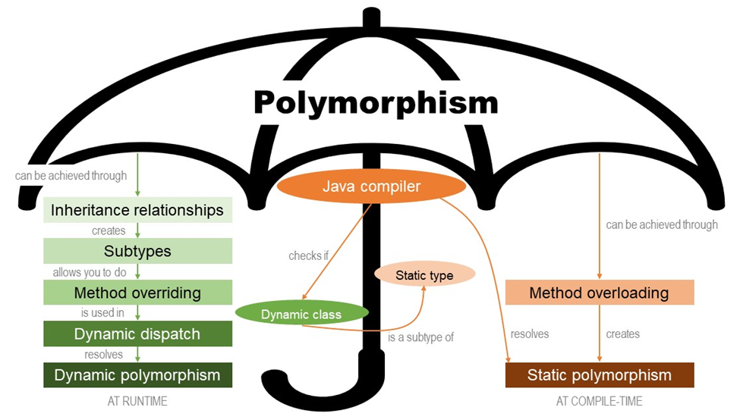
5.4 Polymorphism

Slide 24
5.6 instanceof and getClass()
equals() method should be symmetric. That is, for two objects x and y, if x.equals(y), then y.equals(x).
Core Concept: Typecasting
Typecasting allows you to create an alias with a different static type.
Upcasting Casting from a subtype to a supertype. Always works.
Downcasting Casting from a supertype to a subtype. Can cause a ClassCastException. To prevent ClassCastException, perform an instanceof check before downcasting.

Slide 25
5.6 instanceof and getClass()
Use getClass() to Check True Dynamic Class
Inside the equals() method, we would like to typecast to a class if the input parameter has exactly the same dynamic class as the current object. This way, we can be sure that if the two objects have the same values for their member attributes—and the same set of member attributes because they are from the same dynamic class—the objects must be structurally equal. Then, we can avoid the asymmetric behavior

Slide 26
Which National Park is it?
Answer: Arches National Park

